Slide 1

Low-Cost Optical Communications System
By: Team 3 (Jarrod Siglin, Cameron Martinez, Sean Huber, Matthew Simms, Dylan Koch, Dominic Steiner)

Slide 2
Introduction
Optical Communications is a relatively new technology that allows for rapid, high-bandwidth wireless transmission of data across nearly any distance.
This technology can transfer data at rates much faster than radio, microwave, or other contemporary technologies (over 100Gbps), all the while using less power, a smaller payload size, and an overall smaller/lighter physical design.
Researching and developing Optical Communication Systems will benefit multiple industries, especially the Aerospace Industry, as transmissions across the solar system would require less power and time to receive the same amount of information compared to a different transmission style.
Proliferation of this technology would lead to a decrease in cost and difficulty in application; can have positive impacts for other industries that already require fast, wireless transfer of data.
Notes:
Introduction o These slides are your “Elevator” Talk (you MUST transfer enough information at this time, so the audience can walk away from the presentation, and still know what your project is all about, and what you have accomplished, this is also known as the “60,000 feet view” of your project) o What is the project benefit to society o Why it is important to have such product

Slide 3
Design Considerations
Size:
System shall fit within 1U (10 in x10 in x10 in).
System shall weigh less than 20 pounds.
Cost
System shall cost under $1500 USD.
System shall use commercial-off-the-shelf (COTS) components.
Implementation
System shall use a 1550 nm wavelength laser diode (NIR-C class)
System shall use Python and shell scripting for all software implementation.
Notes:
Design Considerations o Assumptions, dependencies o General Constraints o Industrial Standards Followed (if there are any) o Safety constraints and considerations o Other

Slide 4
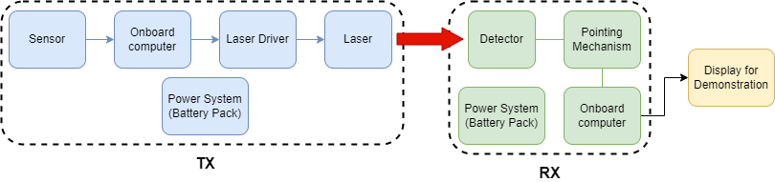
System Architecture
The transmitter will use a Raspberry Pi 4 with the camera sensor, will be able to transcode the signal into an O.O.K. using a UART transmission standard.
The receiver will also use a Raspberry Pi 4 to decode the UART input and transcode into a MJPEG video stream to display/record.
The communication will be performed via a 1552nm laser through free space to a 0.04mm diameter detector.
Notes:
System Architecture: Start at the high level of abstractions, and then get to the detail. o Architectural Diagram / Details o Description of major sub-systems o Communication Architecture

Slide 5
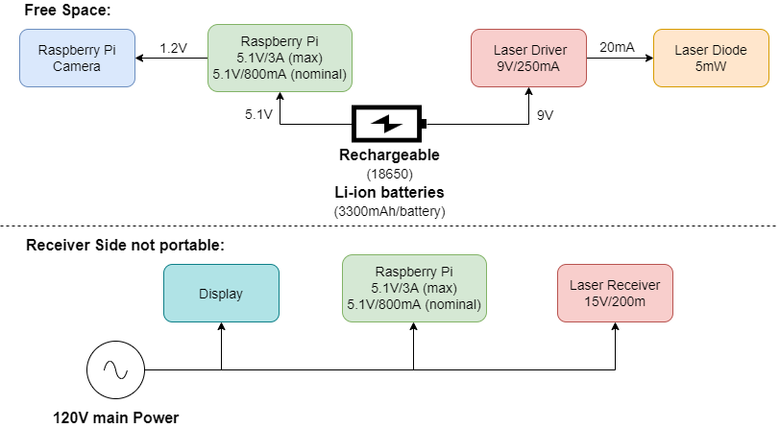
Sub-System Design
Battery system to power the Raspberry pi, camera sensor and laser diode, while in an independent state.
Base station that will be able wait for an incoming signal, to decode.
Receiver needs amplification system for increase power of signal.
Notes:
Sub-System Design: Start at the high level of abstraction, then get to the detail as you move through your presentation. o Overview o Software Class Diagram(s) (high level) – or – Hardware Diagram(s) (high level) o Interfaces / Exports o Parts budget (if needed)

Slide 6
Lessons Learned
Lasers lose power over distance and spread greatly.
Coordinating meeting times is very difficult with more team members.
Most off-the-shelf-commercial parts are for highly specific purposes rather than generic or generalized uses and still need to configured towards the system's specs.
Projects can be delayed to unforeseen circumstances.
Reliable communication with the customer is very important.
Notes:
Remember to shout-out Ian for the time off.

Slide 7
Project Timeline
Sprint 1:
Constructed overall table-top layout.
Currently able to transmit 1.35 mW, 1552 nm sinusoidal wave with laser diode.
Observed considerable loss over free-space propagation.
Researched signal amplification options.
Sprint 2:
In process of soldering 1kΩ resistor for greater power output from the laser driver.
Uses lenses to increase range.
Consistently read signal from receiver on an oscilloscope.
Begin coding of Raspberry Pi for amplitude modulation.
Sprint 3:
Integrate camera to transmitter and a visual display to receiver.
Design and create power sub-systems for transmitter.
Increase range of system.

Slide 8
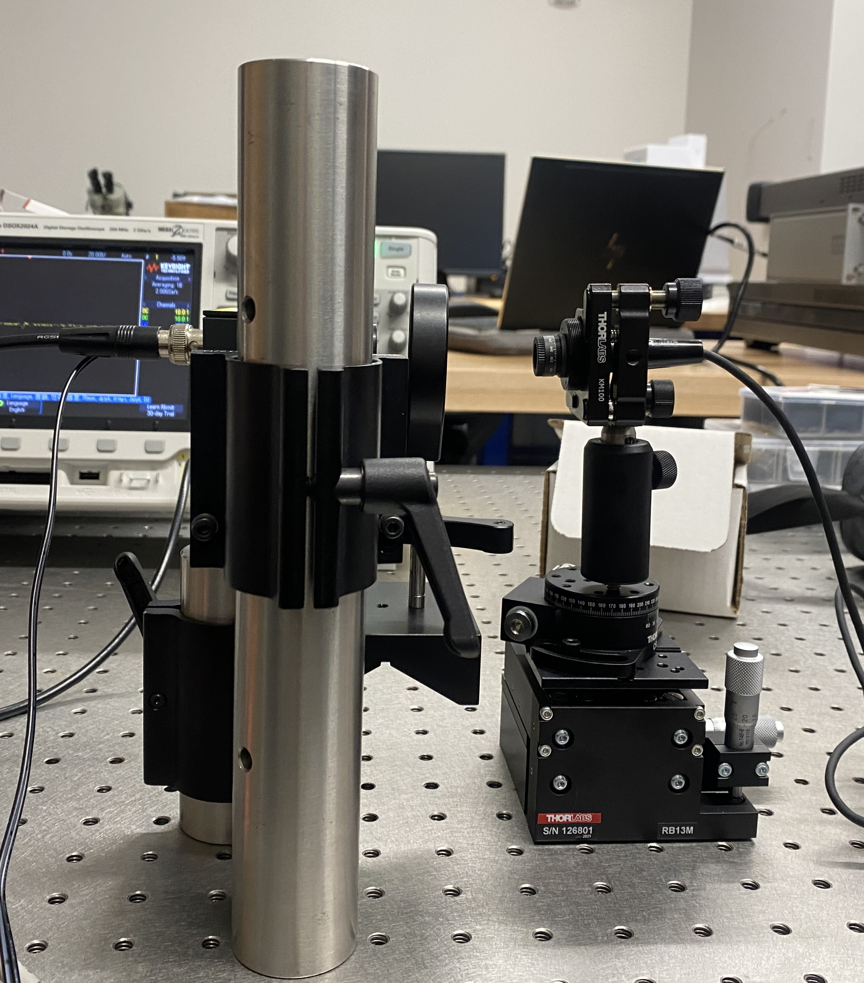
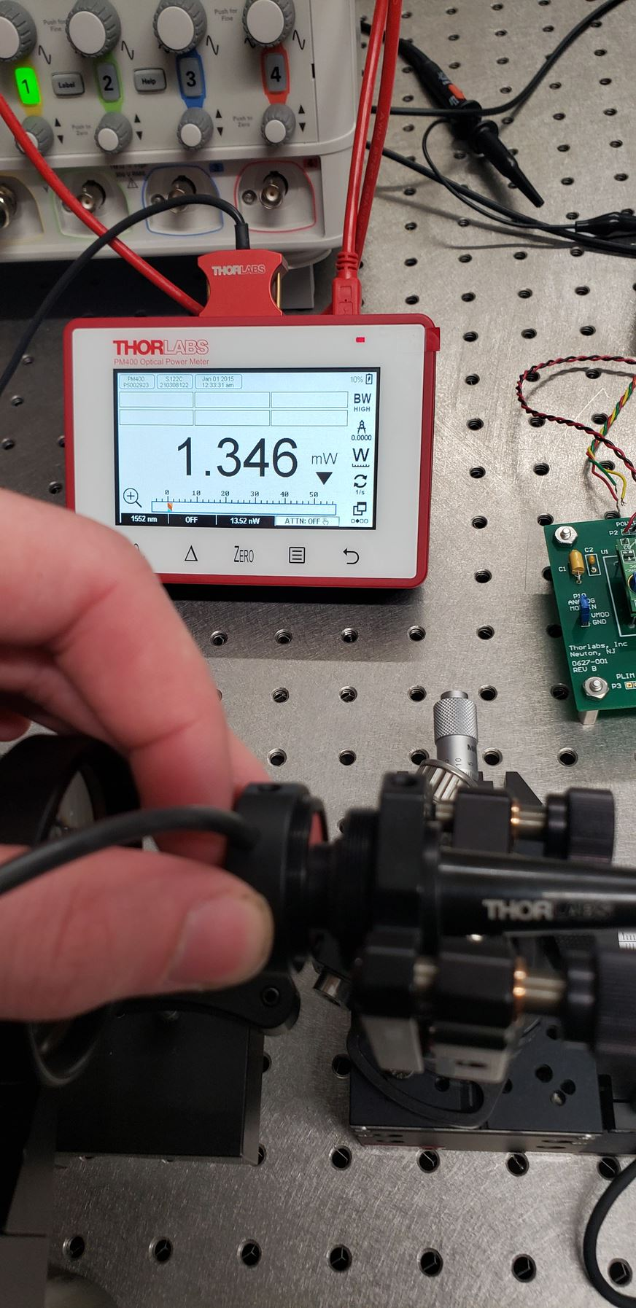
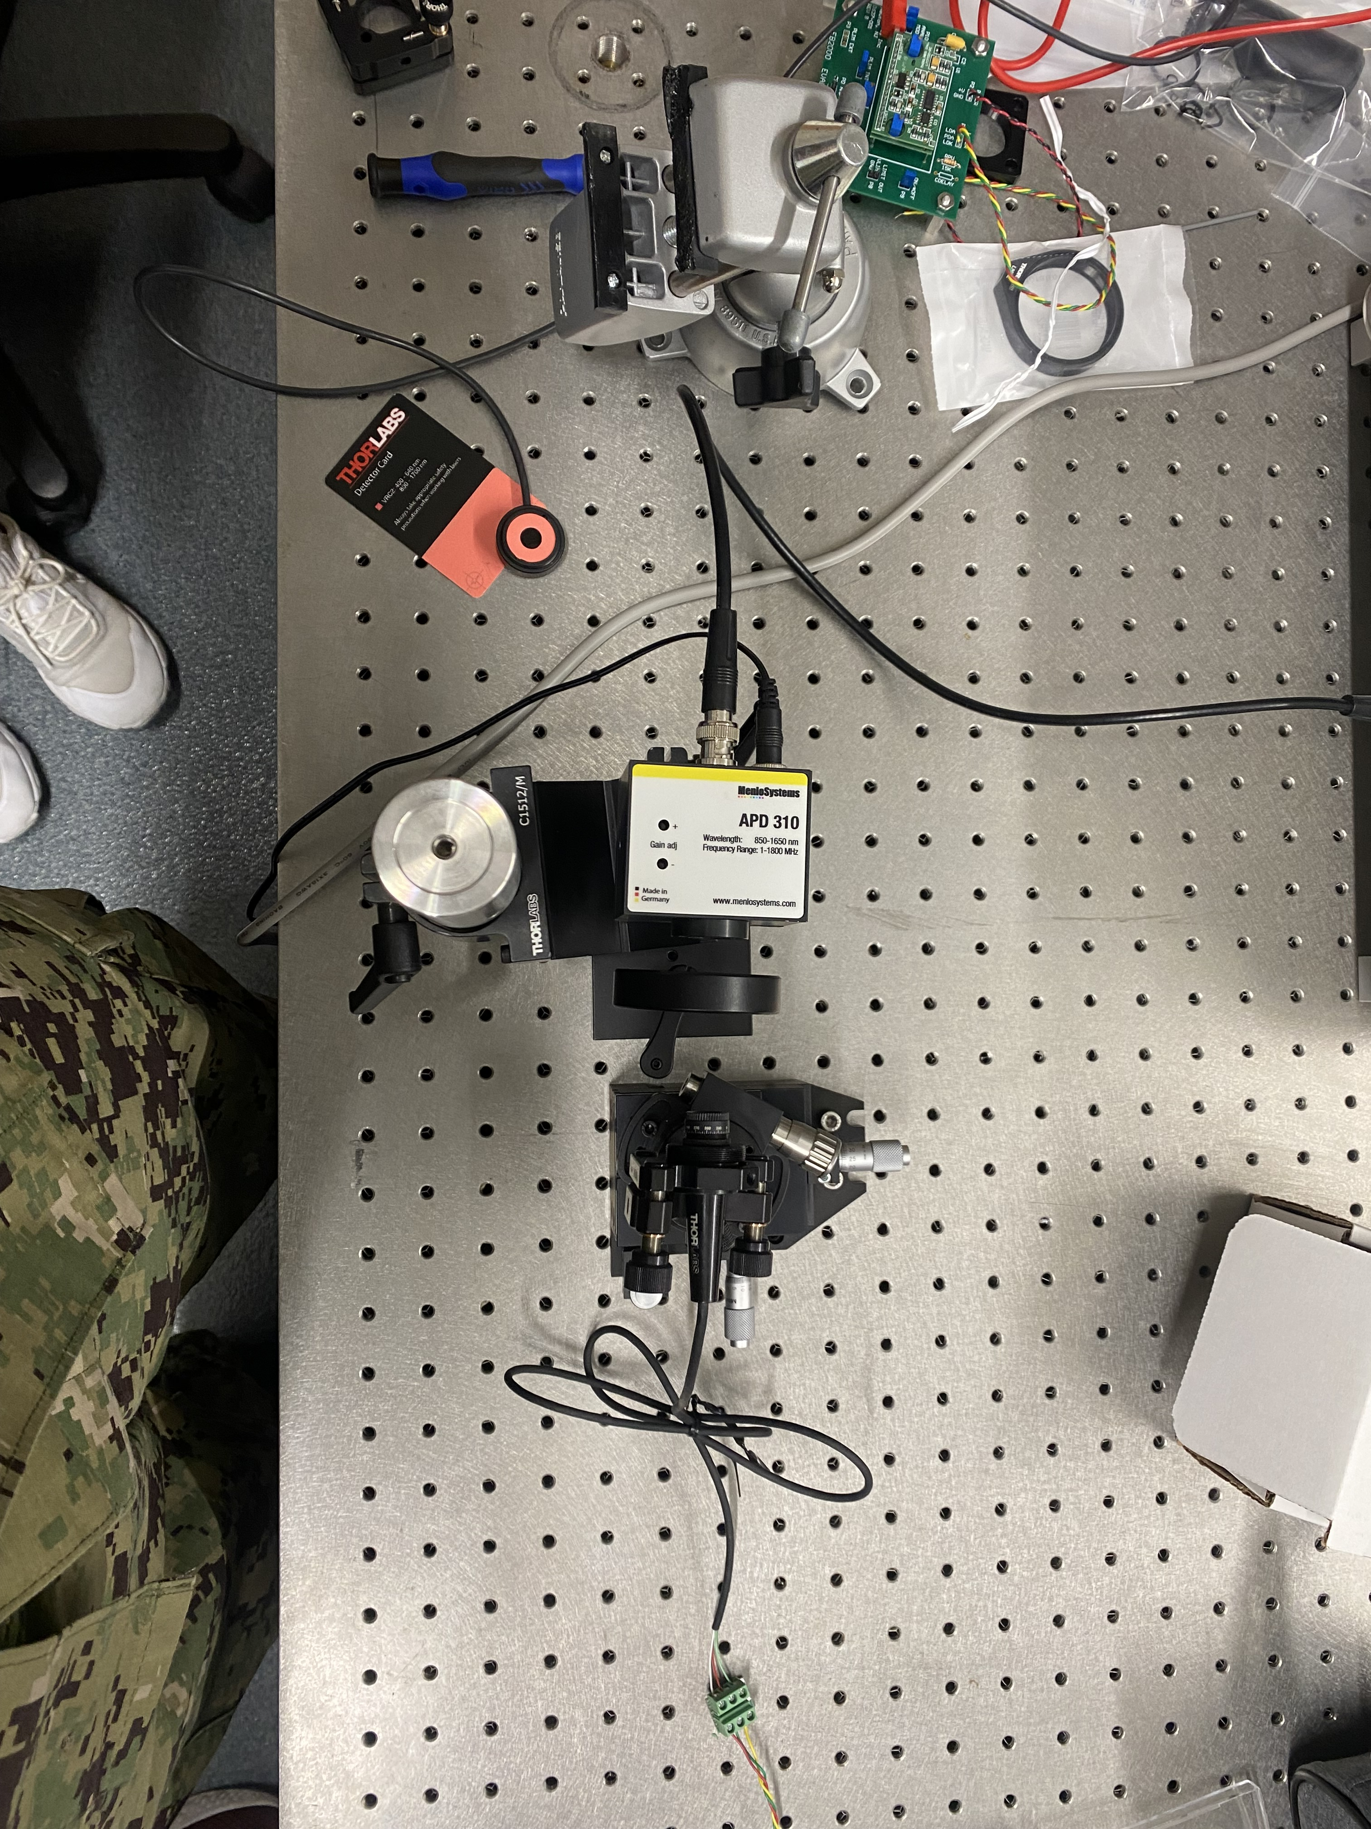
Sprint 1: Current top down (left) and side profile (middle) of setup, as well as laser diode power readings (right)

Slide 9
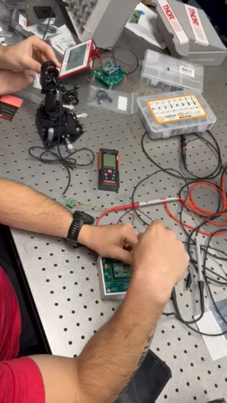
Sprint 1: Increased received power from 1.3 mW to almost 4 mW.

Slide 10
Questions?
Ask away!

